Slide 1
Bioinformatics & Algorithmics.
www.stats.ox.ac.uk/hein/lectures.
Strings.
Trees.
Trees & Recombination.
Structures: RNA.
A Mad Algorithm
Open Problems.
Questions for the audience.
Complexity Results.

Slide 2
Bioinformatics & Algorithmics.
www.stats.ox.ac.uk/hein/lectures, http://www.stats.ox.ac.uk/mathgen/bioinformatics/index.html
Strings.
Trees.
Trees & Recombination.
Structures: RNA.
Haplotype/SNP Problems.
Genome Rearrangements + Genome Assembly.

Slide 3
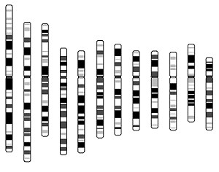
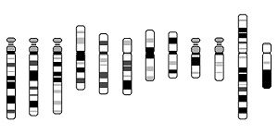
Zooming in!(from Harding + Sanger)
3*10⁹ bp
*5.000
-globin
(chromosome 11)
6*10⁴ bp
Exon 3
*20
Exon 1
Exon 2
3*10³ bp
5’ flanking
3’ flanking
*10³
ATTGCCATGTCGATAATTGGACTATTTTTTTTTT
30 bp

Slide 4
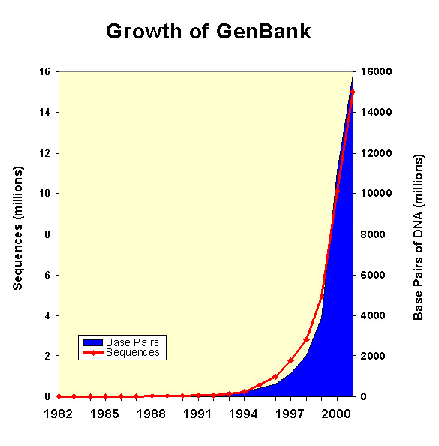
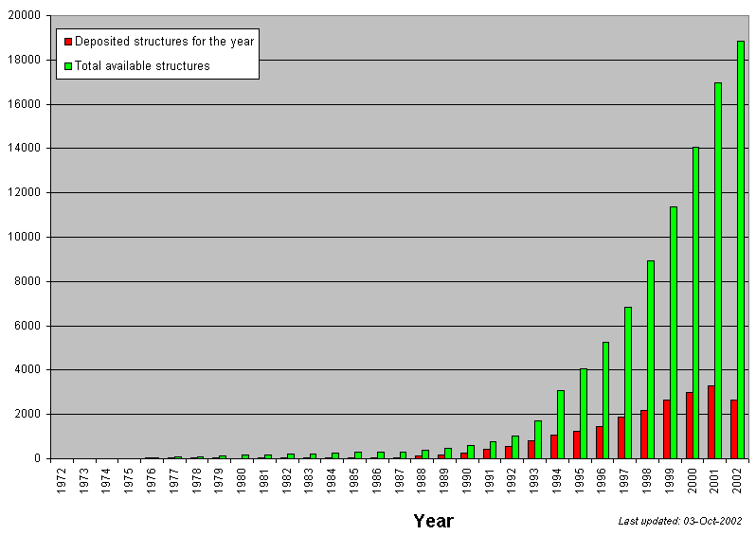
Biological Data: Sequences, Structures……..
Known protein structures.
http://www.ncbi.nlm.nih.gov/Genbank/genbankstats.html
http://www.rcsb.org/pdb/holdings.html

Slide 5
What is an algorithm?
A precise recipe to perform a task on a precise class of data.
The word is derived form the name, al Khuwarizmi - a 9th century arab mathematician.
Example: Euclids algorithm for finding largest common divisor of two integer, n & m.
Keep subtracting the smaller from the larger until you are left with two equal numbers.
Ex. n=2*3²*5=90, m=2*5*17=170 (obviously LCD=10)
(90,170)→(90,80)→(10,80)→(10,10)

Slide 6
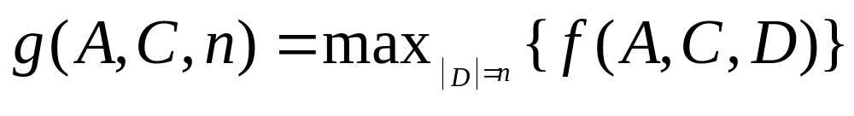
The O-notation.
The running time of a program is a complicated function of:
Algorithm
Computer
Input-Data.
Like f(A,C,D)
Data is only measured through its size, not through its content. The content independence is obtained through assuming the worst case data.
Still complicated

Slide 7
Big O
To simplify this and make measure of computational need comparable, the O (small & big) - notation has been introduced.
In words: f will grow as g within multiplication of a constant.
1.6g
f
Running Time
g
n₀
Data Size
Big computers are a constant factor better than small computers, so the characterisation of an algorithm by O( ) is now computer-independent.

Slide 8
Recursions
Recursion:= Definition by self-reference and triviality!!
DAG – Direct Acyclic Graphs.
Sources: only outgoing edges.
Sinks: only ingoing edges.
DAG nodes can be enumerated so arrows always point to large nodes.

Slide 9
A permutation example:
(1, 2, 3, 4, 5)
How many permutations are there of 5 objects?
Two ways to count:
(5, 1, 4, 3, 2)
Number-by-number:
Enlarging small permutations:
( , , , , )
( 1 )
5 choices.
2 choices.
(5, , , , )
(1, 2 )
4 choices.
3 choices.
(5, , 4, , )
(1, 3, 2 )
3 choices.
(5, , 4, 3, )
4 choices.
(1, 4, 3, 2 )
2 choices.
(5, , 4, 3, 2)
5 choices.
1 choice
(5, 1, 4, 3, 2)
(5, 1, 4, 3, 2)

Slide 10
Permutations & Factorial
Permutations: The number of putting n distinct balls in n distinct jars or re-orderings of (1,2,3,4,..,n)→(σ₁,σ₂,σ₃,σ₄,..,σ_{n}).
(σ₁,σ₂,σ₃,σ₄,..,σ_{n-1})
(1)
n possible placements of σ_{n}
(1,2)
(1,2)
(1,3,2)
(σ₁,σ₂,σ₃,σ₄,..,σ_{n})
Factorial – number of permutations: n!=n*(n-1)!, 1!=1. n!=n*(n-1)*..*1:=n!
1
2
3
4
n-1
n
*2
*3
*4
*n
1!
2!
3!
4!
n-1!
n!
1
2
6
24

Slide 11
Counting by Bijection
Bijection to a decision series:
Level 0
Level 1
1
2
3
k₁
N=k₁*k₂*...*k_{L}
Level 2
1
2
3
k₂
Level L
1
2
3
N

Slide 12
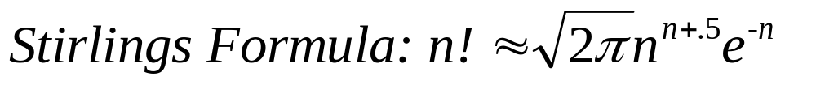
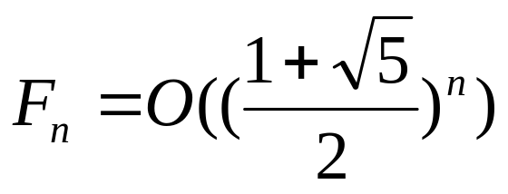
Asymptotic Growth of Recursive Functions
Describing the growth of such discrete functions by simple continuous functions like x^{b}e^{cx} can be valuable. At least two ways are often used.
Many involve factorials which can be approaximated by Stirlings Formula
ii. Direct inspection of the recursion can characterise asymptotic growth.
Fibonacci Numbers: F_{n}=F_{n-1} + F_{n-2}, F₁=a (1) F₂=b (1)
independent of a & b.

Slide 13
Recursions
Power function: f(n)=k*f(n-1), f(1)=1. f(n)=k^{n}.
log(x)
Logarithm: ln(a*b)=ln(a)+ln(b)
logarithm are
continuous & increasing
log_{k}(x) = ln_{e}k*ln_{k}(x) is
log₂(2x) = ln₂(2)+ ln₂(x)
x
log(x)
2⁰ 2¹ 2² 2³ 2⁴ 2⁵
2^{x}

Slide 14
Beware:All balls (or LETTERS) have the same color!!
Initialisation: One ball has the same colour.
Induction: If a set n-1 balls has the same colour, then sets of n balls have the same colour.
1
2
n-1
n
Proof:
=
=
1
2
3
4
n-1
n

Slide 15
Trees – graphical & biological.
A graph is a set vertices (nodes) {v₁,..,v_{k}} and a set of edges {e₁=(v_{i1},v_{j1}),..,e_{n}=(v_{in},v_{jn})}. Edges can be directed, then (v_{i},v_{j}) is viewed as different (opposite direction) from (v_{j},v_{i}) - or undirected.
v₁
(v₁→v₂)
v₂
(v₂, v₄)
or (v₄, v₂)
v₄
v₃
Nodes can be labelled or unlabelled. In phylogenies the leaves are labelled and the rest unlabelled.
The degree of a node is the number of edges it is a part of. A leaf has degree 1.
A graph is connected, if any two nodes has a path connecting them.
A tree is a connected graph without any cycles, i.e. only one path between any two nodes.

Slide 16
Trees & phylogenies.
A tree with k nodes has k-1 edges. (easy to show by induction).
A root is a special node with degree 2 that is interpreted as the point furthes back in time. The leaves are interpreted as being contemporary.
A root introduces a time direction in a tree.
A rooted tree is said to be bifurcating, if all non-leafs/roots has degree 3, corresponding to 1 ancestor and 2 children. For unrooted tree it is said to have valency 3.
Edges can be labelled with a positive real number interpreted as time duration or amount or evolution.
If the length of the path from the root to any leaf is the same, it obeys a molecular clock.
Tree Topology: Discrete structure – phylogeny without branch lengths.
Root
Leaf
Internal Node
Internal Node
Leaf

Slide 17
Binary Search.
Given an ordered set, {a₁,a₂,..a_{n}}, and a proposed member of this set, b. Find b’s position!
Algorithm:
Find element in the middle position.
Is b bigger than a_{middle} go right, if smaller go left.
a_{middle}
{b<a_{middle}}
{b>a_{middle}}
a’_{middle}
a’_{middle}

Slide 18
Binary Search.
Max Height: log₂(n)

Slide 19
Grammars: Finite Set of Rules for Generating Strings
A starting symbol:
A set of substitution rules applied to variables - - in the present string:
Regular
Context Free
Context Sensitive
General (also erasing)
finished – no variables

Slide 20
Chomsky Linguistic Hierarchy
Source: Biological Sequence Comparison
W nonterminal sign, a any sign, α, β, γ are strings, but β, not null string. ε Empty String
Regular Grammars W --> aW’ W --> a
Context-Free Grammars W --> β
Context-Sensitive Grammars α₁Wα₂ --> α₁ β α₂
Unrestricted Grammars α₁Wα₂ --> γ
The above listing is in increasing power of string generation. For instance "Context-Free Grammars" can generate all sequences "Regular Grammar" can in addition to some more.

Slide 21
Simple String Generators
Terminals (capital) --- Non-Terminals (small)
i. Start with S S --> aT bS
T --> aS bT ε
One sentence – odd # of a’s:
S-> aT -> aaS –> aabS -> aabaT -> aaba
ii. S--> aSa bSb aa bb
One sentence (even length palindromes):
S--> aSa --> abSba --> abaaba

Slide 22
Stochastic Grammars
The grammars above classify all string as belonging to the language or not.
All variables has a finite set of substitution rules. Assigning probabilities to the use of each rule will assign probabilities to the strings in the language.
If there is a 1-1 derivation (creation) of a string, the probability of a string can be obtained as the product probability of the applied rules.
i. Start with S. S --> (0.3)aT (0.7)bS
T --> (0.2)aS (0.4)bT (0.2)ε
*0.3
*0.2
*0.7
*0.3
*0.2
S -> aT -> aaS –> aabS -> aabaT -> aaba
ii. S--> (0.3)aSa (0.5)bSb (0.1)aa (0.1)bb
*0.3
*0.5
*0.1
S -> aSa -> abSba -> abaaba

Slide 23
Abstract Machines recognising these Grammars.
Regular Grammars - Finite State Automata
Context-Free Grammars - Push-down Automata
Context-Sensitive Grammars - Linear Bounded Automaton
Unrestricted Grammars - Turing Machine

Slide 24
NP-Completeness
Is a set of combinatorial optimisation problems that most likely are computationally hard with a worst case running time growing faster than any polynomium. Lots of biological problems are NP-complete.

Slide 25
The first NP-Completeness result in biology
For aligned set of sequences find the tree topology that allows the simplest history in terms of weighted mutations.
s7
s5
s2
s1
s3
s6
s5
1 atkavcvlkgdgpqvqgsinfeqkesdgpvkvwgsikglte-glhgfhvhqfg----ndtagct---sagphfnp-lsrk
2 atkavcvlkgdgpqvqgtinfeak-gdtvkvwgsikglte—-glhgfhvhqfg----ndtagct---sagphfnp-lsrk
3 atkavcvlkgdgpqvqgsinfeqkesdgpvkvwgsikglte-glhgfhvhqfg----ndtagct---sagphfnp-lsrk
4 atkavcvlkgdgpqvq -infeak-gdtvkvwgsikglte—-glhgfhvhqfg----ndtagct---sagphfnp-lsrk
5 atkavcvlkgdgpqvq— infeqkesdgpvkvwgsikglte—glhgfhvhqfg----ndtagct---sagphfnp-lsrk
6 atkavcvlkgdgpqvq— infeak-gdtvkvwgsikgltepnglhgfhvhqfg----ndtagct---sagphfnp-lsrk
7 atkavcvlkgdgpqvq—-infeqkesdgpv--wgsikgltglhgfhvhqfgscasndtagctvlggssagphfnpehtnk

Slide 26
Branch & Bound Algorithms
Root
Search Tree:
U - (low) upper bound,
C(n) - Cost of sub-solution at node n.
n
L₁
L₂
L₃
L₄
R(n) - (high) low bound on cost of completion of solution.
If R(n) + C(n) >= U, then ignore descendants of n.
U can decrease as the solution space is investigated.
Example U = 12, C(n) = 8 & R(n) = 5 => ignore L₁ & L₂.

Slide 27
Alignment is VERY important.
http://www.stats.ox.ac.uk/~hein/lectures.htm
α-globin (141) and β-globin (146)
V-LSPADKTNVKAAWGKVGAHAGEYGAEALERMFLSFPTTKTYFPHF-DLS--H---GSAQVKGHGKKVADAL
VHLTPEEKSAVTALWGKV--NVDEVGGEALGRLLVVYPWTQRFFESFGDLSTPDAVMGNPKVKAHGKKVLGAF
TNAVAHVDDMPNALSALSDLHAHKLRVDPVNFKLLSHCLLVTLAAHLPAEFTPAVHASLDKFLASVSTVLTSKYR
SDGLAHLDNLKGTFATLSELHCDKLHVDPENFRLLGNVLVCVLAHHFGKEFTPPVQAAYQKVVAGVANALAHKYH
It often matches functional region with functional region.
Determines homology at residue/nucleotide level.
3. Similarity/Distance between molecules can be evaluated
4. Molecular Evolution studies.
5. Homology/Non-homology depends on it.
Alignment is too important

Slide 28
T
G
T
T
C T A G G
Alignment
Matrix Path
CTAGG
TT-GT

Slide 29
Number of alignments, T(n,m)
1 9 41 129 321 681
T
1 7 25 63 129 231
G
1 5 13 25 41 61
T
1 3 5 7 9 11
T
1 1 1 1 1 1
C T A G G
Notes:
Make overhead showing identification between paths & alignments.

Slide 30
Parsimony Alignment of two strings.
Sequences: s1=CTAGG s2=TTGT.
Basic operations:
transitions 2 (C-T & A-G), transversions 5, indels (g) 10.
CTAG CTA G
Cost Additivity = +
TT-G TT- G
(A) {CTA,TT}_{AL} + GG
? 0
{CTAG,TTG}_{AL} = (B) {CTA,TTG}_{AL} + G-
? ? 10
(C) {CTAG,TT}_{AL} + -G
? 10

Slide 31
40 32 22 14 9 17
T
30 22 12 4 12 22
G
20 12 2 12 22 32
T
10 2 10 20 30 40
T
0 10 20 30 40 50
C T A G G
CTAGG
Alignment: i v Cost 17
TT-GT

Slide 32
Accelerations of pairwise algorithm
ε {
Exact acceleration (Ukkonen,Myers).
Assume all events cost 1.
If d_{ε}(s₁,s₂) <2ε+|l₁-l₂|, then
d(s₁,s₂)= d_{ε}(s₁,s₂)
Heuristic acceleration: Smaller band & larger acceleration, but no guarantee of optimum.

Slide 33

Alignment of many sequences.
s1=ATCG, s2=ATGCC, ......., sn=ACGCG
Alignment: AT-CG s1 s3 s4
ATGCC \ ! /
..... ----------
..... / \
ACGCG s2 s5
Configurations in an alignment column: 2^{n}-1
Recursion: D_{i}=min{D_{i-∆} + d(i,∆)} ∆ [{0,1}^{n}\{0}^{n}]
Initial condition: D_{0,0,..0} = 0.
Computation time: l^{n}*(2^{n}-1)*n Memory requirement: l^{n} (l:sequence length, n:number of sequences)

Slide 34
Longer Indels
TCATGGTACCGTTAGCGT
GCA-----------GCAT
g_{k} :cost of indel of length k.
Initial condition: D_{0,0}=0
D_{i,j} = min {
D_{i-1,j-1} + d(s1[i],s2[j]),
D_{i,j-1} + g₁,D_{i,j-2} + g₂,,
D_{i-1,j} + g₁,D_{i-2,j} + g₂,,
}
Cubic running time. Quadratic memory.
(i-2,j)
(i-1,j)
(i,j)
(i,j-1)
(i,j-2)
Evolutionary Consistency Condition: g_{i} + g_{j} > g_{i+j}

Slide 35
If g_{k} = a + b*k, then quadratic running time.
Gotoh (1982) D_{i,j} is split into 3 types:
1. D0_{i,j} as D_{i,j}, except s1[i] must mactch s2[j].
2. D1_{i,j} as D_{i,j}, except s1[i] is matched with "-".
3. D2_{i,j} as D_{i,j}, except s2[i] is matched with "-".
n
n
+
n
n
n
n
+
+
0:
n
-
+
n
n
1:
n
-
2:
-
n
-
n
+
n
-
+
-
n
+
Then:D0_{i,j} = min(D0_{i-1,j-1}, D1_{i-1,j-1}, D2_{i-1,j-1}) + d(s1[i],s2[j])
D1_{i,j} = min(D1_{i,j-1} + b, D0_{i,j-1} + a + b)
D2_{i,j} = min(D2_{i-1,j} + b, D0_{i-1,j} + a + b)
Notes:
Add Hirschberg after This.

Slide 36
Distance-Similarity.
(Smith-Waterman-Fitch,1982)
D_{i,j}=min{D_{i-1,j-1} + d(s1[i],s2[j]), D_{i,j-1} +g, D_{i-1,j} +g}
S_{i,j}=max{D_{i-1,j-1} + s(s1[i],s2[j]), S_{i,j-1} -w, S_{i-1,j}-w}
Distance: Transitions:2 Transversions 5 Indels:10
M largest distance between two nucleotides (5).
Similarity
s(n1,n2) M - d(n1,n2)
w_{k} k/(2*M) + g_{k}
w 1/(2*M) + g
Similarity Parameters:
Transversions:0 Transitions:3 Identity:5 Indels: 10 + 1/10
Notes:
Include derivation of this

Slide 37
40/-40.4 32/-27.3 22/-12.2 14/0.9 9/11.0 17/2.9
T
30/-30.3 22/-17.2 12/-2.1 4/11.0 12/2.9 22/-7.2
G
20/-20.2 12/-7.1 2/8.0 12/-2.1 22/-12.2 32/-22.3
T
10/-10.1 2/3.0 10/-7.1 20/-17.2 30/-27.3 40/-37.4
T
0/0 10/-10.1 20/-20.2 30/-30.3 40/-40.4 50/-50.5
C T A G G
Comments
1. The Switch from Dist to Sim is highly analogous to Maximizing {-f(x)} instead of Minimizing {f(x)}.
2. Dist will based on a metric:
i. d(x,x) =0, ii. d(x,y) >=0, iii. d(x,y) = d(y,x) &
iv. d(x,z) + d(z,y) >= d(x,y).
There are no analogous restrictions on Sim, giving it a larger parameter space.
Notes:
Make similarity data set that can’t be translated into distance parameters.

Slide 38
Needleman-Wunch Algorithm(1970)
Initial condition: S_{0,0}=0
S_{i,j} = max { S_{i-1,j-1} + s(s1[i],s2[j]),
S_{i,j-1} - g,S_{i,j-2} - g,S_{i,j-3} - g,,
S_{i-1,j} - g,S_{i-2,j} - g,S_{i-3,j} - g,,
}
Cubic running time. Quadratic memory.

Slide 39
Local alignment
Smith,Waterman (1981
Global Alignment: S_{i,j}=max{D_{i-1,j-1} + s(s1[i],s2[j]), S_{i,j-1} -w, S_{i-1,j}-w}
Local: S_{i,j}=max{D_{i-1,j-1} + s(s1[i],s2[j]), S_{i,j-1} -w, S_{i-1,j}-w,0}
0 1 0 .6 1 2 .6 1.6 1.6 3 2.6 Score Parameters:
C
0 0 1 0 1 .3 .6 0.6 2 3 1.6 Match: 1
A
0 0 0 1.3 0 1 1 2 3.3 2 1.6 Mismatch -1/3
G /
0 0 .3 .3 1.3 1 2.3 2.3 2 .6 1.6 Gap 1 + k/3
C /
0 0 .6 1.6 .3 1.3 2.6 2.3 1 .6 1.6 GCC-UCG
U / GCCAUUG
0 0 2 .6 .3 1.6 2.6 1.3 1 .6 1
A !
0 1 .6 0 1 3 1.6 1.3 1 1.3 1.6
C /
0 1 0 0 2 1.3 .3 1 .3 2 .6
C /
0 0 0 1 .3 0 0 .6 1 0 0
G /
0 0 0 .6 1 0 0 0 1 1 2
U
0 0 1 .6 0 0 0 0 0 0 0
A
0 0 1 0 0 0 0 0 0 0 0
A
0 0 0 0 0 0 0 0 0 0 0
C A G C C U C G C U U

Slide 40
Progressive Alignment
(Feng-Doolittle 1987 J.Mol.Evol.)
Can align alignments and given a tree make a multiple alignment.
* *
alkmny-trwq acdeqrt
akkmdyftrwq acdehrt
kkkmemftrwq
[ P(n,q) + P(n,h) + P(d,q) + P(d,h) + P(e,q) + P(e,h)]/6
* * *** * * * * * *
Sodh atkavcvlkgdgpqvqgsinfeqkesdgpvkvwgsikglte-glhgfhvhqfg----ndtagct sagphfnp lsrk
Sodb atkavcvlkgdgpqvqgtinfeak-gdtvkvwgsikglte—-glhgfhvhqfg----ndtagct sagphfnp lsrk
Sodl atkavcvlkgdgpqvqgsinfeqkesdgpvkvwgsikglte-glhgfhvhqfg----ndtagct sagphfnp lsrk
Sddm atkavcvlkgdgpqvq -infeak-gdtvkvwgsikglte—-glhgfhvhqfg----ndtagct sagphfnp lsrk
Sdmz atkavcvlkgdgpqvq— infeqkesdgpvkvwgsikglte—glhgfhvhqfg----ndtagct sagphfnp Lsrk
Sods vatkavcvlkgdgpqvq— infeak-gdtvkvwgsikgltepnglhgfhvhqfg----ndtagct sagphfnp lsrk
Sdpb datkavcvlkgdgpqvq—-infeqkesdgpv----wgsikgltglhgfhvhqfgscasndtagctvlggssagphfnpehtnk
Sodb
Sodl
sddm
Sodh
Sdmz
sods
Sdpb

Slide 41
Assignment to internal nodes: The simple way.
A
T
G
C
?
?
?
?
?
?
C
C
C
A
What is the cheapest assignment of nucleotides to internal nodes, given some (symmetric) distance function d(N₁,N₂)??
If there are k leaves, there are k-2 internal nodes and 4^{k-2} possible assignments of nucleotides. For k=22, this is more than 10¹².

Slide 42
5S RNA Alignment & Phylogeny
Hein, 1990
3
4
5
6
11
13
9
7
15
17
14
10
12
16
Transitions 2, transversions 5
Total weight 843.
8
2
1
10 tatt-ctggtgtcccaggcgtagaggaaccacaccgatccatctcgaacttggtggtgaaactctgccgcggt--aaccaatact-cg-gg-gggggccct-gcggaaaaatagctcgatgccagga--ta
17 t--t-ctggtgtcccaggcgtagaggaaccacaccaatccatcccgaacttggtggtgaaactctgctgcggt--ga-cgatact-tg-gg-gggagcccg-atggaaaaatagctcgatgccagga--t-
9 t--t-ctggtgtctcaggcgtggaggaaccacaccaatccatcccgaacttggtggtgaaactctattgcggt--ga-cgatactgta-gg-ggaagcccg-atggaaaaatagctcgacgccagga--t-
14 t----ctggtggccatggcgtagaggaaacaccccatcccataccgaactcggcagttaagctctgctgcgcc--ga-tggtact-tg-gg-gggagcccg-ctgggaaaataggacgctgccag-a--t-
3 t----ctggtgatgatggcggaggggacacacccgttcccataccgaacacggccgttaagccctccagcgcc--aa-tggtact-tgctc-cgcagggag-ccgggagagtaggacgtcgccag-g--c-
11 t----ctggtggcgatggcgaagaggacacacccgttcccataccgaacacggcagttaagctctccagcgcc--ga-tggtact-tg-gg-ggcagtccg-ctgggagagtaggacgctgccag-g--c-
4 t----ctggtggcgatagcgagaaggtcacacccgttcccataccgaacacggaagttaagcttctcagcgcc--ga-tggtagt-ta-gg-ggctgtccc-ctgtgagagtaggacgctgccag-g--c-
15 g----cctgcggccatagcaccgtgaaagcaccccatcccat-ccgaactcggcagttaagcacggttgcgcccaga-tagtact-tg-ggtgggagaccgcctgggaaacctggatgctgcaag-c--t-
8 g----cctacggccatcccaccctggtaacgcccgatctcgt-ctgatctcggaagctaagcagggtcgggcctggt-tagtact-tg-gatgggagacctcctgggaataccgggtgctgtagg-ct-t-
12 g----cctacggccataccaccctgaaagcaccccatcccgt-ccgatctgggaagttaagcagggttgagcccagt-tagtact-tg-gatgggagaccgcctgggaatcctgggtgctgtagg-c--t-
7 g----cttacgaccatatcacgttgaatgcacgccatcccgt-ccgatctggcaagttaagcaacgttgagtccagt-tagtact-tg-gatcggagacggcctgggaatcctggatgttgtaag-c--t-
16 g----cctacggccatagcaccctgaaagcaccccatcccgt-ccgatctgggaagttaagcagggttgcgcccagt-tagtact-tg-ggtgggagaccgcctgggaatcctgggtgctgtagg-c--t-
1 a----tccacggccataggactctgaaagcactgcatcccgt-ccgatctgcaaagttaaccagagtaccgcccagt-tagtacc-ac-ggtgggggaccacgcgggaatcctgggtgctgt-gg-t--t-
18 a----tccacggccataggactctgaaagcaccgcatcccgt-ccgatctgcgaagttaaacagagtaccgcccagt-tagtacc-ac-ggtgggggaccacatgggaatcctgggtgctgt-gg-t--t-
2 a----tccacggccataggactgtgaaagcaccgcatcccgt-ctgatctgcgcagttaaacacagtgccgcctagt-tagtacc-at-ggtgggggaccacatgggaatcctgggtgctgt-gg-t--t-
5 g---tggtgcggtcataccagcgctaatgcaccggatcccat-cagaactccgcagttaagcgcgcttgggccagaa-cagtact-gg-gatgggtgacctcccgggaagtcctggtgccgcacc-c--c-
13 g----ggtgcggtcataccagcgttaatgcaccggatcccat-cagaactccgcagttaagcgcgcttgggccagcc-tagtact-ag-gatgggtgacctcctgggaagtcctgatgctgcacc-c--t-
6 g----ggtgcgatcataccagcgttaatgcaccggatcccat-cagaactccgcagttaagcgcgcttgggttggag-tagtact-ag-gatgggtgacctcctgggaagtcctaatattgcacc-c-tt-

Slide 43
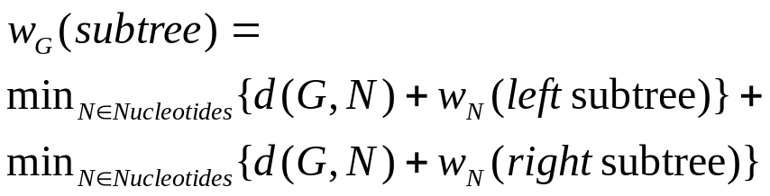
Cost of a history - minimizing over internal states
A C G T
d(C,G) +w_{C}(left subtree)
A C G T
A C G T

Slide 44
Cost of a history – leaves (initialisation).
A C G T
Initialisation: leaves
Cost(N)= 0 if
N is at leaf,
otherwise infinity
G
A
Empty
Cost 0
Empty
Cost 0

Slide 45
Fitch-Hartigan-Sankoff Algorithm
(A,C,G,T)
(9,7,7,7) Costs: Transition 2,
/ \ Transversion 5.
/ \
/ \
(A, C, G, T) \
(10,2,10,2) \
/ \ \
/ \ \
/ \ \
/ \ \
/ \ \
(A,C,G,T) (A,C,G,T) (A,C,G,T)
* 0 * * * * * 0 * * 0 *
The cost of cheapest tree hanging from this node given there is a “C” at this node
A
C
G
T

Slide 46
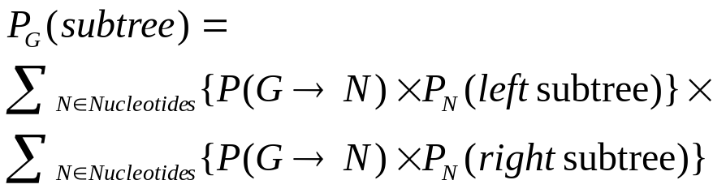
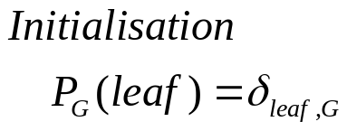
Probability of leaf observations - summing over internal states
A C G T
P(C→G) *P_{C}(left subtree)
A C G T
A C G T

Slide 47
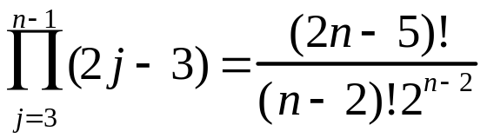
Enumerating Trees: Unrooted & valency 3
1
2
3
1
2
1
3
1
2
4
3
2
4
3
4
5
1
2
5
1
1
2
1
2
1
2
2
3
4
3
4
3
5
4
3
5
4
3
4
5
Recursion: T_{n}= (2n-5) T_{n-1}
Initialisation: T₁= T₂= T₃=1
4 | 5 | 6 | 7 | 8 | 9 | 10 | 15 | 20
3 | 15 | 105 | 945 | 10345 | 1.4 10⁵ | 2.0 10⁶ | 7.9 10¹² | 2.2 10²⁰

Slide 48
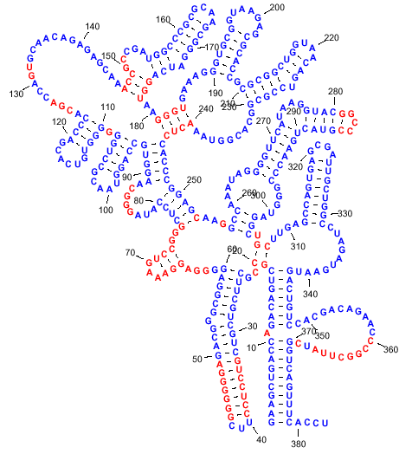
RNA Secondary Structure

Slide 49
RNA SS: recursive definition
Nussinov (1978) remade from Durbin et al.,1997
Secondary Structure : Set of paired positions on inteval [i,j].
A-U + C-G can base pair. Some other pairings can occur + triple interactions exists.
Pseudoknot – non nested pairing:
i < j < k < l and i-k & j-l.
i+1
j-1
i+1
j
i
j-1
i
j
i
j
i
j
k
k+1
i,j pair
i unpaired
j unpaired
bifurcation

Slide 50
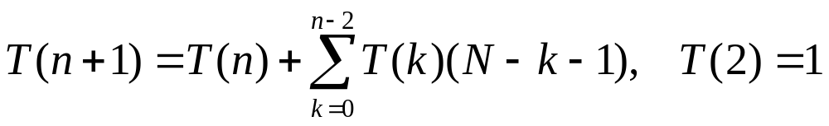
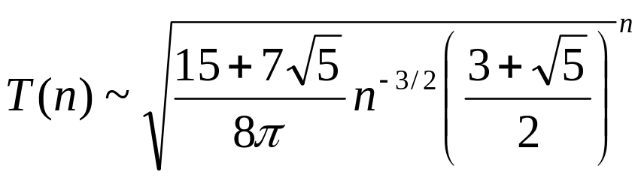
RNA Secondary Structure
(
)
N₁
N_{L}
(
)
(
)
N₁
N_{L}
N₁
N_{L}
)
)
N₁
N_{L}
N₁
)
(
N_{k}
N_{k+1}
N_{L}
)
)
The number of secondary structures:

Slide 51
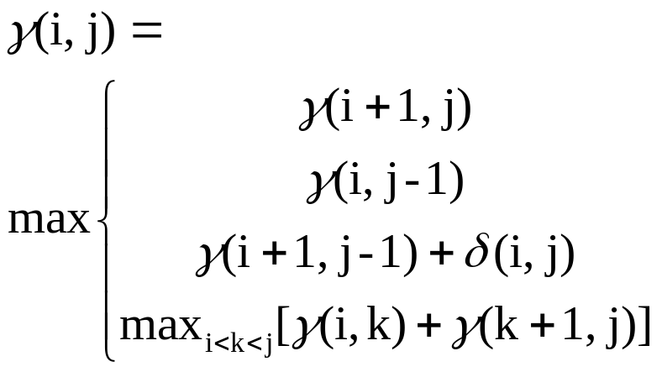
RNA: Matching Maximisation.
remade from Durbin et al.,1997
Example: GGGAAAUCC (A-U & G-C)
j
G G G A A A U C C
0 | 0 | 0² | 0³ | 0⁴ | 0⁵ | 1⁶ | 2⁷ | 3
0 | 0 | 0 | 0 | 0 | 0 | 1 | 2 | 3²
 | 0 | 0 | 0 | 0 | 0 | 1 | 2 | 2³
 |  | 0 | 0 | 0 | 0 | 1 | 1 | 1⁴
 |  |  | 0 | 0 | 0 | 1 | 1 | 1⁵
 |  |  |  | 0 | 0 | 1 | 1 | 1⁶
 |  |  |  |  | 0 | 0 | 0 | 0⁷
 |  |  |  |  |  | 0 | 0 | 0
 |  |  |  |  |  |  | 0 | 0
A
A
G G G A A A U C
A
U
i
G
C
G
C
G

Slide 52
2 Haplotype Problems
SNPs → Haplotypes
Defining Haplotype Blocks

Slide 53
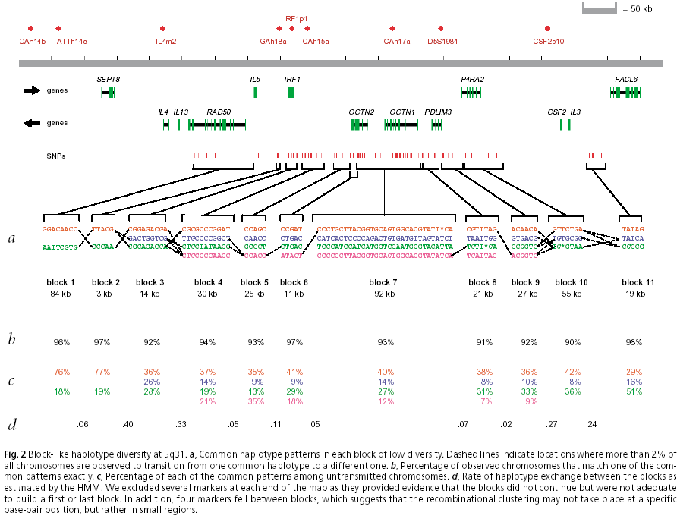
Biological Data: Variation Data
Daly,JM et al.(2001) High-resolution haplotype structure in the human genome. Nat.Gen. 29.229-32.
Haplotypes:
T
C
A
A
G
C
SNPs:
{A,T}
{C,G}
{A,C}

Slide 54
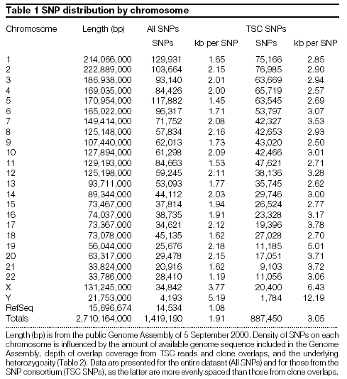
Biological Data: Variation Data
Inter.SNP Consortium (2001): A map of human genome sequence variation containing 1.42 million SNPs. Nature 409.928-33

Slide 55
The effect of a recombination on Trees.
1
2
3
4

Slide 56
Recombination Parsimony
Data
1
2
3
Trees
T
1
2
i-1
i
L
Recursion:W(T,i)= min_{T’}{W(T’,i-1) + subst(T,i) + d_{rec}(T,T’)}
Fast heuristic version can be programmed.
Notes:
Remove

Slide 57
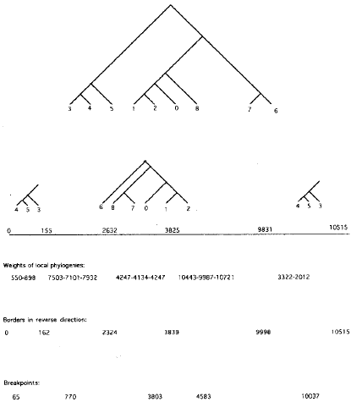
Recombination Parsimony: Example - HIV
Costs:
Recombination - 100
Substitutions - (2-5)
Notes:
Remove

Slide 58
Metrics on Trees based on subtree transfers.
The easy problem:
1
5
1
5
2
2
3
4
6
6
2
4
3
The real problem:
3
1
6
2
4
5
3
1
2
3
4
5
6
Pretending the easy problem is the real problem, causes violation of the triangle inequality:

Slide 59
Subtree transfer- and recombination metrics are different!
Due to Thomas Christensen
2
3
5
7
3
1
5
8
9
7
8
4
9
6
1
4
6
2
3
1
5
7
9
4
8
2
6

Slide 60
Turning cabbage into a turnip
Cabbage
8
7
6
5
4
3
2
1
11
10
9
8
7
6
5
4
3
2
1
11
10
9
8
2
3
4
5
6
7
1
11
10
9
8
2
3
4
5
1
7
6
11
10
9
4
3
2
8
5
1
7
6
11
10
9
4
3
2
8
7
1
5
6
11
10
9
4
3
2
8
7
1
5
6
11
10
9
Turnip
4
3
2
8
7
1
5
6
11
10
9
From Miklos

Slide 61
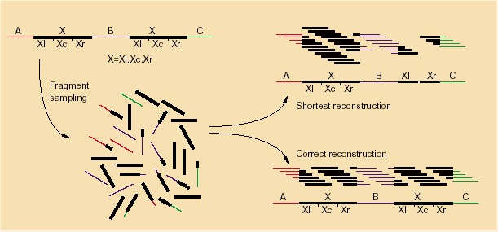
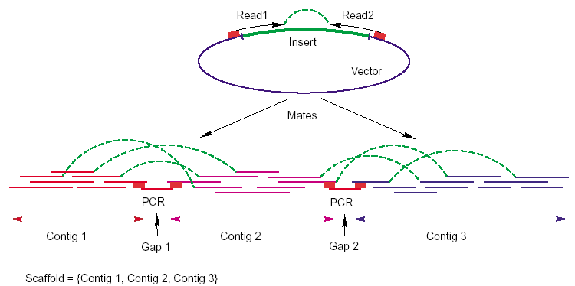
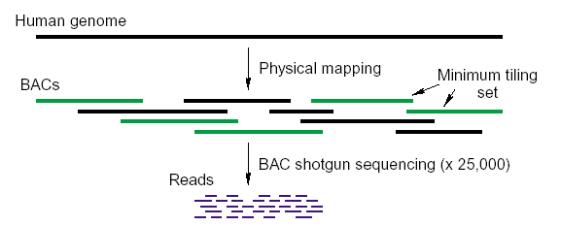
Sequencing Strategies From Myers, 99
The problem:
Public effort- strategy:
Myers - strategy:

Slide 62
What is needed.
Heuristics are very dominating in the analysis of biological data.
Proper analysis of heuristics.
Other classes of algorithms
Randomized Algorithms
Approximation Algorithms
Combined Numerical Optimisation/Combinatorial Optimisation Algorithms
More relevant complexity measures
Mean time complexity from the uniform distribution
Mean time complexity from a relevant distribution
Computer Science
Statistics.
Mathematical/Physical Modelling

Slide 63

Basic Pairwise Recursion (O(length³))
i
j
Survives:
i-1
i
Dies:
i-1
i
j-1
j
j
i-1
i
i-1
i
j-2
j
j-1
j
……………………
……………………
……………………
……………………
……………………
……………………
1… j (j) cases
0… j (j+1) cases
Notes:
Add slide showing why this gives l to the third.

Slide 64
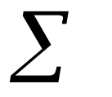
Structure of Dynamical Programming in Bioinformatics.
Optimisation: Minimisation or Maximisation
Min/Max
Addition
Weight/Cost
Markovian Structure:
Multiplication
Probability

Slide 65
Summary
Strings.
Trees.
Trees & Recombination.
Structures: RNA.
Haplotype/SNP Problems.
Genome Rearrangements + Genome Assembly.

Slide 66
Literature & www-sites
Books
Durbin, R. et al.(1996) Biological Sequence Analysis CUP
Garey & Johnson (1979) Computers and Intractability: A Guide to the theory of NP-Completeness. Addison-Wesley
Gusfield, D.(1996) Trees, Strings and Sequences. CUP
Jiang, T.(eds.) (2002) Computational Molecular Biology MIT
Martin, J.C. (1997) Introduction to Languages and the Theory of Computation. 2nd edition. McGraw-Hill
Papadimitriou, C.(1991) Computational Complexity. Addison-Wesley
Pevzner, P.A.(2000) Computational Molecular Biology: An Algorithmic Approach. MIT
Suhai, S. (eds.) (1997) Theoretical and Computational Methods in Genome Research. Plenum Press.
Articles:
Myers, E. ``Whole-Genome DNA Sequencing,'' IEEE Computational Engineering and Science 3, 1 (1999), 33-43.

Slide 67
Literature & www-sites
Journals
http://bioinformatics.oupjournals.org/
http://www.liebertpub.com/CMB/default1.asp
http://www.academicpress.com/www/journal/bu.htm
Conferences:
http://www.ismb02.org/
http://www.ctw-congress.de/recomb/
http://www.dis.uniroma1.it/~algo02/wabi02/
http://www.informatik.uni-trier.de/~ley/db/conf/cpm/
www-sites:
http://www.math.tau.ac.il/~rshamir/
http://www.cs.ucsd.edu/users/ppevzner/
http://www.cs.arizona.edu/people/gene/
http://www.cs.arizona.edu/~kece/
http://www.cas.mcmaster.ca/~jiang/
http://www.cs.huji.ac.il/~nirf/
http://www-hto.usc.edu/people/Waterman.html
http://www.rakbio.oulu.fi/ukkonenproject.html

Slide 68
History of Algorithms in Bioinformatics
1970 Needleman & Wunch presents first biology inspired alignment algorithm.
1973 Sankoff combines the phylogeny and alignment problem.
1978 Nussinov presents first dynamical programming algorithm for RNA folding.
1981 The simple parsimony phylogeny problem is shown to be NP-Complete.
1985 Ukkonen presents corner cutting string algorithm.
1989 Sankoff analyzes genome rearrangements.
1995 Hannerhali & Pevzner present cubic algorithm for sorting by inversions.
1997 Myers & Weber proposes pure shotgun sequencing strategy.
2001 Gusfield proposes SNP→ Haplotype polynomial algorithm.
2002 Many proposes algorithms for haplotype blocks.

